Slide 1
Session 4: Data Warehouse & OLAP
Lecturer: Dr. Le Hoang Son
Vietnam National University (VNU)
lehoangson@hus.edu.vn
sonlh@vnu.edu.vn

Slide 2
Contents
1
What is Data Warehouse?
2
Multidimensional data model
3
Data Warehouse Architecture
4
Implementation
5
Integrate with Data Mining
6
Discussion & Exercises

Slide 3
1. What is Data Warehouse?
A data warehouse refers to a database that is maintained separately from an organization’s operational databases
A data warehouse is a subject-oriented, integrated, time-variant, and nonvolatile collection of data in support of management’s decision making process
  Subject-oriented: A data warehouse is organized around major subjects, such as customer, supplier, product, and sales
  Integrated: A data warehouse is usually constructed by integrating multiple heterogeneous sources (relational databases, flat files, and on-line transaction records)
  Time-variant: Data are stored to provide information from a historical perspective (past 5–10 years)
  Nonvolatile: A data warehouse is always a physically separate store of data transformed from the application data. It usually requires only two operations in data accessing: initial loading of data and access of data
Data warehousing = constructing + using data warehouses

Slide 4
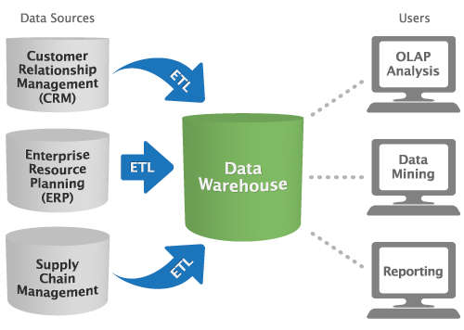
Data Warehouse

Slide 5
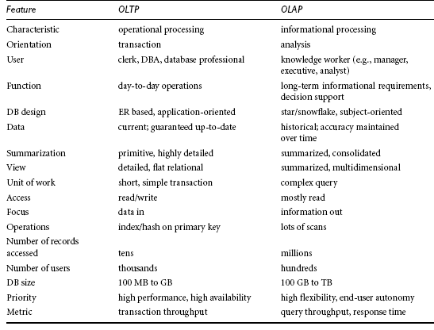
Operational Database Systems vs. Data Warehouses
Online transaction processing (OLTP) vs. online analytical processing (OLAP)
Notes:
The major task of on-line operational database systems is to perform on-line transaction and query processing. These systems are called on-line transaction processing (OLTP) systems. They cover most of the day-to-day operations of an organization, such as purchasing, inventory, manufacturing, banking, payroll, registration, and accounting. Data warehouse systems, on the other hand, serve users or knowledge workers in the role of data analysis and decision making. Such systems can organize and present data in various formats in order to accommodate the diverse needs of the different users. These systems are known as on-line analytical processing (OLAP) systems.
Users and system orientation: An OLTP system is customer-oriented and is used for
transaction and query processing by clerks, clients, and information technology professionals.
An OLAP systemis market-oriented and is used for data analysis by knowledge
workers, including managers, executives, and analysts.
Data contents: An OLTP systemmanages current data that, typically, are too detailed
to be easily used for decision making. An OLAP system manages large amounts of
historical data, provides facilities for summarization and aggregation, and stores and
manages information at different levels of granularity. These features make the data
easier to use in informed decision making.
Database design: An OLTP system usually adopts an entity-relationship (ER) data
model and an application-oriented database design.An OLAP systemtypically adopts
either a star or snowflake model (to be discussed in Section 3.2.2) and a subjectoriented
database design.
View: An OLTP system focuses mainly on the current data within an enterprise or
department, without referring to historical data or data in different organizations.
In contrast, an OLAP system often spans multiple versions of a database schema,
due to the evolutionary process of an organization. OLAP systems also deal with
information that originates from different organizations, integrating information
from many data stores. Because of their huge volume, OLAP data are stored on
multiple storage media.
Access patterns: The access patterns of anOLTP systemconsist mainly of short, atomic
transactions. Such a system requires concurrency control and recovery mechanisms.
However, accesses to OLAP systems are mostly read-only operations (because most data warehouses store historical rather than up-to-date information), although many
could be complex queri

Slide 6
Contents
1
What is Data Warehouse?
2
Multidimensional data model
3
Data Warehouse Architecture
4
Implementation
5
Integrate with Data Mining
6
Discussion & Exercises

Slide 7
2. Multidimensional data model
Data warehouses and OLAP tools are based on a multidimensional data model. This model views data in the form of a data cube
Dimensions are the perspectives or entities with respect to which an organization wants to keep records. Each dimension may have a table associated with it, called a dimension table
A multidimensional data model is typically organized around a central theme represented by a fact table
Although we usually think of cubes as 3-D geometric structures, in data warehousing the data cube is n-dimensional

Slide 8
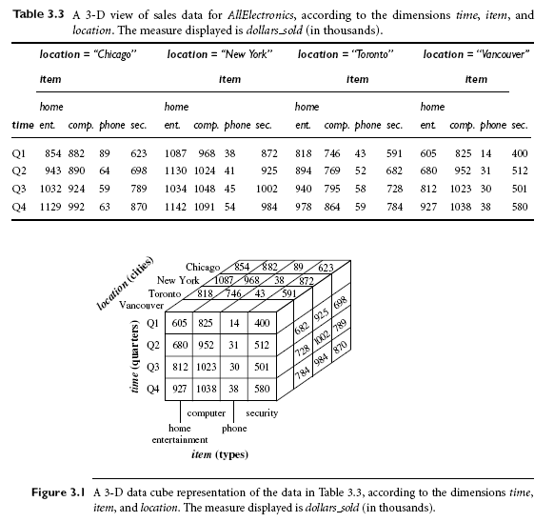
3D Data Cube

Slide 9
Question?
Suppose that we would now like to view our sales data with an additional fourth dimension, such as supplier?
Viewing things in 4D becomes tricky. However, we can think of a 4D cube as being a series of 3D cubes
The important thing to remember is that data cubes are n-dimensional and do not confine data to 3D

Slide 10
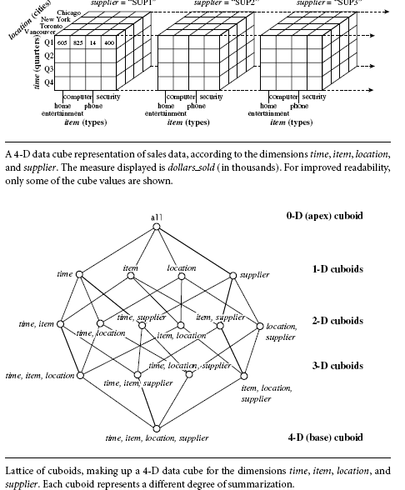
4D Data Cube

Slide 11
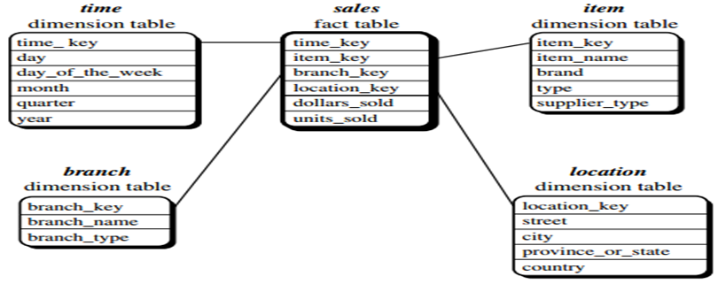
Stars schema
A large central table (fact table) containing the bulk of the data, with no redundancy
A set of smaller attendant tables (dimension tables), one for each dimension
The schema graph resembles a starburst, with the dimension tables displayed in a radial pattern around the central fact table
Notes:
A star schema for AllElectronics sales is shown in Figure 3.4. Sales are considered along four dimensions, namely, time, item, branch, and location. The schema contains
a central fact table for sales that contains keys to each of the four dimensions, along with
two measures: dollars sold and units sold. To minimize the size of the fact table, dimension
identifiers (such as time key and item key) are system-generated identifiers.

Slide 12
Define Star schema
Data Mining Query Language (DMQL):
define cube sales star [time, item, branch, location]:
dollars sold = sum(sales in dollars), units sold = count(*)
define dimension time as (time key, day, day of week, month, quarter, year)
define dimension item as (item key, item name, brand, type, supplier type)
define dimension branch as (branch key, branch name, branch type)
define dimension location as (location key, street, city, province or state, country)

Slide 13
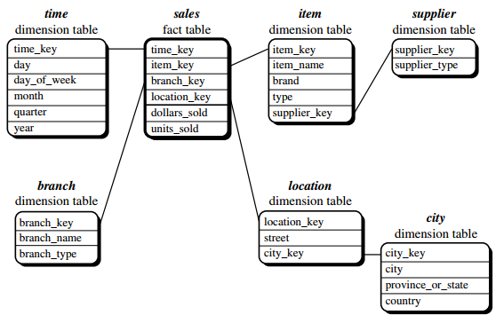
Snowflakes
A variant of the star schema model where some dimension tables are normalized, thereby further splitting the data into additional tables
Snowflake structure can reduce the effectiveness of browsing, since more joins will be needed to execute a query

Slide 14
Define SnowFlakes
Data Mining Query Language (DMQL):
define cube sales snowflake [time, item, branch, location]:
dollars sold = sum(sales in dollars), units sold = count(*)
define dimension time as (time key, day, day of week, month, quarter, year)
define dimension item as (item key, item name, brand, type, supplier (supplier key, supplier type))
define dimension branch as (branch key, branch name, branch type)
define dimension location as (location key, street, city (city key, city, province or state, country))

Slide 15
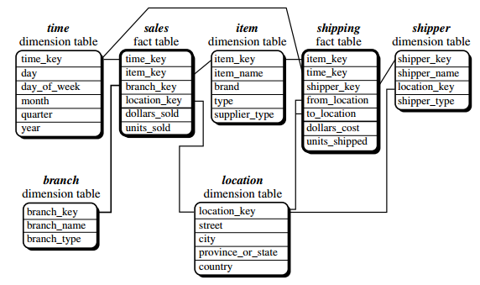
Fact Constellations
Sophisticated applications may require multiple fact tables to share dimension tables. This kind of schema can be viewed as a collection of stars, and hence is called a galaxy schema or a fact constellation
Notes:
This schema specifies two fact tables, sales and shipping
- A data warehouse collects information about subjects that span the entire organization,
such as customers, items, sales, assets, and personnel, and thus its scope is enterprise-wide.
For data warehouses, the fact constellation schema is commonly used, since it can model
multiple, interrelated subjects. A data mart, on the other hand, is a department subset
of the data warehouse that focuses on selected subjects, and thus its scope is departmentwide.

Slide 16
Define Fact Constellation
Data Mining Query Language (DMQL):
define cube sales [time, item, branch, location]:
dollars sold = sum(sales in dollars), units sold = count(*)
define dimension time as (time key, day, day of week, month, quarter, year)
define dimension item as (item key, item name, brand, type, supplier type)
define dimension branch as (branch key, branch name, branch type)
define dimension location as (location key, street, city, province or state, country)
define cube shipping [time, item, shipper, from location, to location]:
dollars cost = sum(cost in dollars), units shipped = count(*)
define dimension time as time in cube sales
define dimension item as item in cube sales
define dimension shipper as (shipper key, shipper name, location as
location in cube sales, shipper type)
define dimension from location as location in cube sales
define dimension to location as location in cube sales

Slide 17
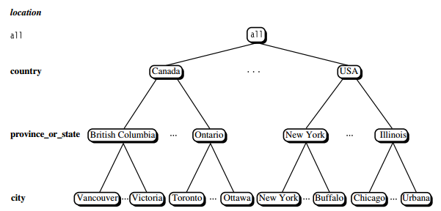
Concept Hierarchies
Defines a sequence of mappings from a set of low-level concepts to higher-level, more general concepts

Slide 18
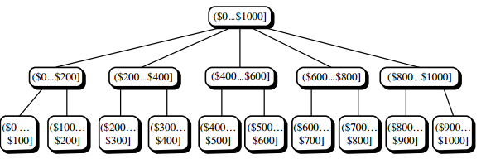
Set-grouping hierarchy
Concept hierarchies may also be defined by discretizing or grouping values for a given dimension or attribute, resulting in a set-grouping hierarchy.
Dimension price, where an interval ($X ... $Y] denotes the range from
$X (exclusive) to $Y (inclusive)

Slide 19
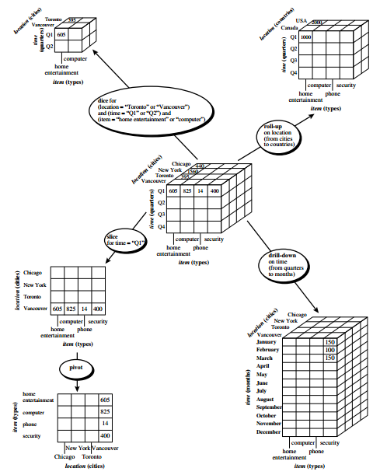
OLAP operations

Slide 20
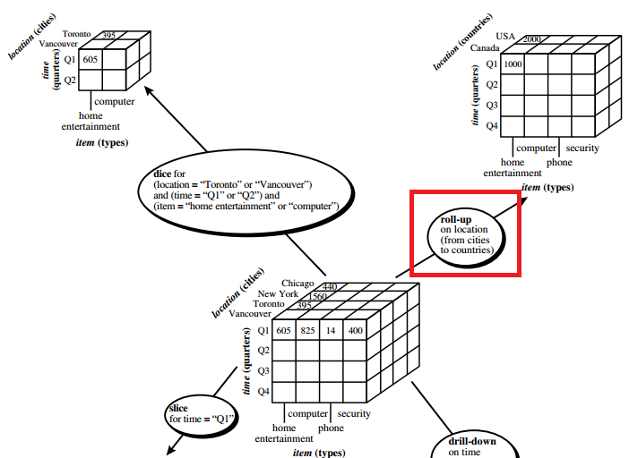
Roll-up operation
Performs aggregation on a data cube:
  Climbing up a concept hierarchy for a dimension
  Dimension reduction
Rather than grouping the data by city, the resulting cube
groups the data by country
When roll-up is performed by dimension reduction, one or more dimensions are
removed from the given cube

Slide 21
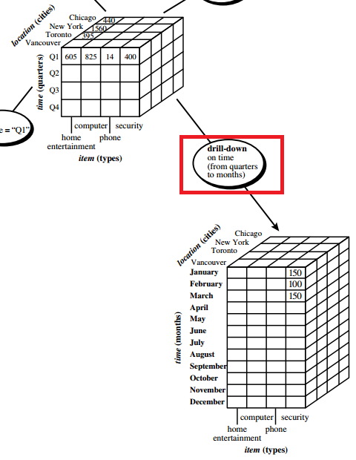
Drill-down operation
Drill-down is the reverse of roll-up
Drill-down can be realized by either stepping down a concept hierarchy for a dimension or introducing additional dimensions
Because a drill-down adds more detail to the given data, it can also be performed by adding new dimensions to a cube

Slide 22
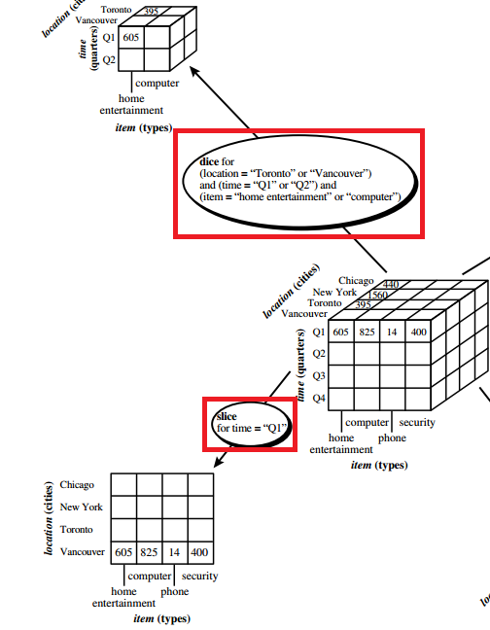
Slice and dice operation
The slice operation performs a selection on one dimension of the given cube, resulting in a sub-cube
The dice operation defines a sub-cube by performing a selection on two or more dimensions

Slide 23
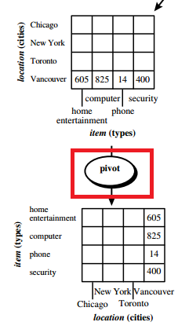
Pivot (rotate) operation
Pivot (also called rotate) is a visualization operation that rotates the data axes in view in order to provide an alternative presentation of the data

Slide 24
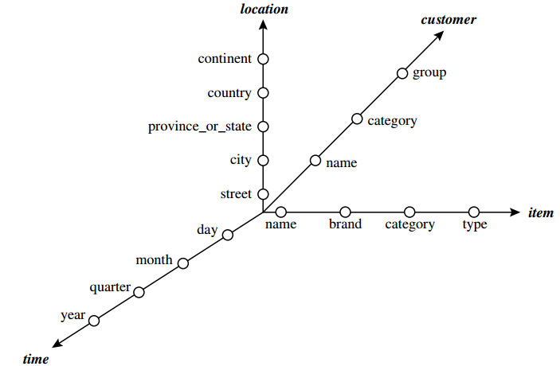
Starnet Query Model
Consists of radial lines emanating from a central point, where each line represents a concept hierarchy for a dimension
Each abstraction level in the hierarchy is called a footprint
These represent the granularities available for use by OLAP operations such as drill-down and roll-up
Notes:
This starnet consists of four radial lines: Each line consists of
footprints representing abstraction levels of the dimension. For example, the time line
has four footprints: “day,” “month,” “quarter,” and “year.
A concept hierarchy may
involve a single attribute (like date for the time hierarchy) or several attributes (e.g.,
the concept hierarchy for location involves the attributes street, city, province or state,
and country). In order to examine the item sales at AllElectronics, users can roll up
along the time dimension from month to quarter, or, say, drill down along the location
dimension from country to city. Concept hierarchies can be used to generalize data
by replacing low-level values (such as “day” for the time dimension) by higher-level
abstractions (such as “year”), or to specialize data by replacing higher-level abstractions
with lower-level values.

Slide 25
Contents
1
What is Data Warehouse?
2
Multidimensional data model
3
Data Warehouse Architecture
4
Implementation
5
Integrate with Data Mining
6
Discussion & Exercises

Slide 26
3. Data Warehouse Architecture
A data warehouse can be built using a top-down approach, a bottom-up approach, or a combination of both
The top-down approach starts with the overall design and planning. It is useful in cases where the technology is mature and well known, and where the business problems that must be solved are clear and well understood
The bottom-up approach starts with experiments and prototypes. This is useful in the early stage of business modeling and technology development
In the combined approach, an organization can exploit the planned and strategic nature of the top-down approach while retaining the rapid implementation and opportunistic application of the bottom-up approach

Slide 27
Warehouse design process
Choose a business process to model. If the business process is organizational and involves multiple complex object collections, a data warehouse model should be followed. However, if the process is departmental and focuses on the analysis of one kind of business process, a data mart model should be chosen.
Choose the grain of the business process. The grain is the fundamental, atomic level of data to be represented in the fact table for this process, for example, individual transactions, individual daily snapshots
Choose the dimensions that will apply to each fact table record. Typical dimensions are time, item, customer, supplier, warehouse
Choose the measures that will populate each fact table record. Typical measures are numeric additive quantities like dollars sold and units sold

Slide 28
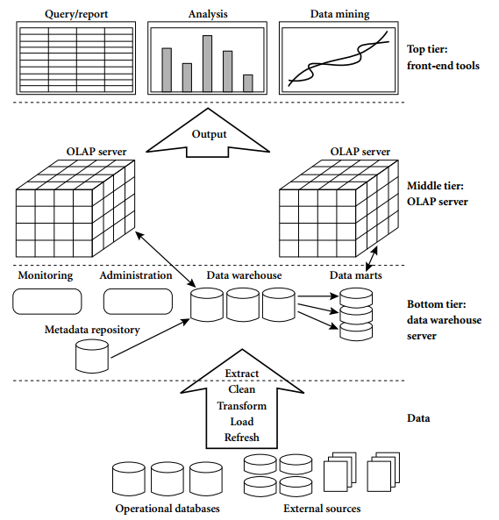
Three-Tier Data Warehouse Architecture

Slide 29
Three-Tier Data Warehouse Architecture
Warehouse database server: relational database system. Back-end tools and utilities are used to feed data into the bottom tier from operational databases or other external sources
OLAP server: implemented using either a relational OLAP (ROLAP) model or a multidimensional OLAP (MOLAP) model
Front-end client: query and reporting tools, analysis tools, and/or data mining tools

Slide 30
Types of OLAP
Relational OLAP (ROLAP) :
  Stand in between a relational back-end server and client front-end tools
  Use a relational or extended-relational DBMS to store and manage warehouse data, and OLAP middleware to support missing pieces
  Include optimization for each DBMS back end, implementation of aggregation navigation logic, and additional tools and services
Multidimensional OLAP (MOLAP):
  Support multidimensional views of data through array-based multidimensional storage engines
  Map multidimensional views directly to data cube array structures
Hybrid OLAP (HOLAP) : combines ROLAP and MOLAP technology, benefiting from the greater scalability of ROLAP and the faster computation of MOLAP

Slide 31
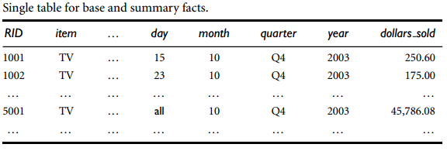
ROLAP data store
Notes:
The schema of the table is “ hrecord identifier (RID), item, ...,
day, month, quarter, year, dollars soldi”, where day, month, quarter, and year define the
date of sales, and dollars sold is the sales amount. Consider the tuples with an RID of 1001
and 1002, respectively. The data of these tuples are at the base fact level, where the date
of sales is October 15, 2003, and October 23, 2003, respectively. Consider the tuple with
an RID of 5001. This tuple is at a more general level of abstraction than the tuples 1001 and 1002. The day value has been generalized to all, so that the corresponding time value
is October 2003. That is, the dollars sold amount shown is an aggregation representing
the entire month of October 2003, rather than just October 15 or 23, 2003. The special
value all is used to represent subtotals in summarized data

Slide 32
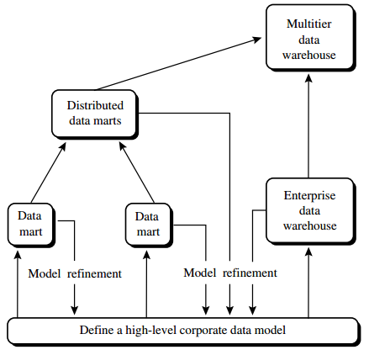
Recommended approach for data warehouse development
Notes:
First, a high-level corporate data model is defined within a reasonably
short period (such as one or two months) that provides a corporate-wide, consistent,
integrated view of data among different subjects and potential usages. This high-level
model, although it will need to be refined in the further development of enterprise
data warehouses and departmental data marts, will greatly reduce future integration
problems. Second, independent data marts can be implemented in parallel with
the enterprise warehouse based on the same corporate data model set as above.
Third, distributed data marts can be constructed to integrate different data marts via
hub servers. Finally, a multitier data warehouse is constructed where the enterprise
warehouse is the sole custodian of all warehouse data, which is then distributed to
the various dependent data marts.

Slide 33
Back-End Tools and Utilities
Data extraction: gathers data from multiple, heterogeneous, external sources
Data cleaning: detects errors in the data and rectifies them when possible
Data transformation: converts data from legacy or host format to warehouse format
Load: sorts, summarizes, consolidates, computes views, checks integrity, and builds indices and partitions
Refresh: propagates the updates from the data sources to the warehouse

Slide 34
Contents
1
What is Data Warehouse?
2
Multidimensional data model
3
Data Warehouse Architecture
4
Implementation
5
Integrate with Data Mining
6
Discussion & Exercises

Slide 35
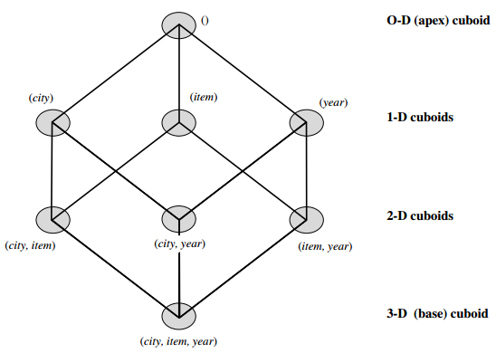
4. Implementation
The compute cube operator computes aggregates over all subsets of the dimensions specified in the operation
  “Compute the sum of sales, grouping by city and item.”
define cube sales cube [city, item, year]: sum(sales in dollars)
compute cube sales cube

Slide 36
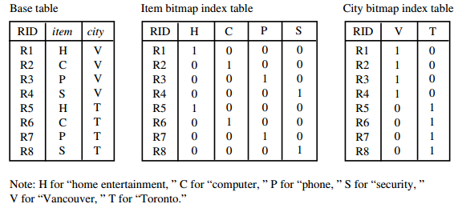
Indexing OLAP Data
To facilitate efficient data accessing, most data warehouse systems support index structures and materialized views (using cuboids)
In the bitmap indexing for a given attribute, there is a distinct bit
vector, Bv, for each value v in the domain of the attribute
Notes:
suppose the dimension item at the top level has four values (representing item types): “home entertainment,” “computer,”“phone,” and “security.” Each value (e.g., “computer”) is represented by a bit vector in the bitmap index table for item. Suppose that the cube is stored as a relation table with 100,000 rows. Because the domain ofitem consists of four values, the bitmap index table requires four bit vectors (or lists), each with 100,000 bits. Figure 3.15 shows a base (data) table containing the dimensions item and city, and its mapping to bitmap index tables for each of the dimensions.

Slide 37
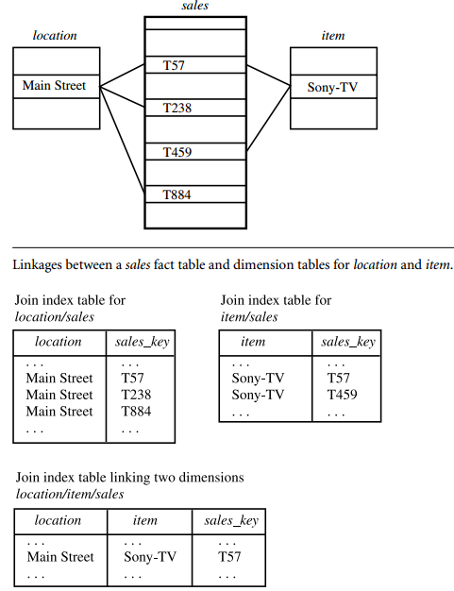
Join Indexing
The join indexing registers the joinable rows of two relations from a relational database.
If two relations R(RID, A) and S(B, SID) join on the attributes A and B, then the join index record contains the pair (RID, SID)
RID and SID are record identifiers from the R and S relations
Notes:
we defined a star schema for AllElectronics of the form “sales star [time, item, branch, location]: dollars sold = sum (sales in dollars)”. An example of a join index relationship between the sales fact table and the dimension tables for location and item is shown in Figure 3.16. For example, the “Main Street” value in the
location dimension table joins with tuples T57, T238, and T884 of the sales fact table. Similarly, the “Sony-TV” value in the item dimension table joins with tuples T57 and T459 of the sales fact table.

Slide 38
Efficient Processing of OLAP Queries
Determine which operations should be performed on the available cuboids:
  This involves transforming any selection, projection, roll-up (group-by), and drill-down operations specified in the query into corresponding SQL and/or OLAP operations
Determine to which materialized cuboid(s) the relevant operations should be applied:
  This involves identifying all of the materialized cuboids that may potentially be used to answer the query

Slide 39
Contents
1
What is Data Warehouse?
2
Multidimensional data model
3
Data Warehouse Architecture
4
Implementation
5
Integrate with Data Mining
6
Discussion & Exercises

Slide 40
5. Integrate with Data Mining
On-line analytical mining (OLAM) (also called OLAP mining) integrates on-line analytical processing (OLAP) with data mining and mining knowledge in multidimensional databases
  High quality of data in data warehouses
  Available information processing infrastructure surrounding data warehouses
  OLAP-based exploratory data analysis
  On-line selection of data mining functions

Slide 41
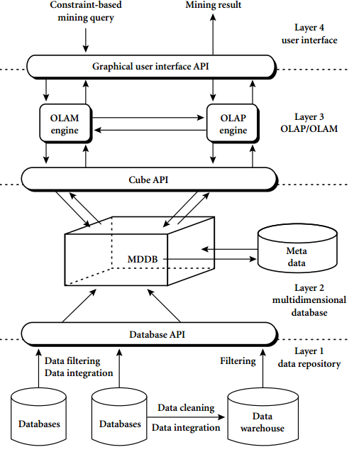
Integrated OLAM and OLAP architecture
Notes:
An OLAM server performs analytical mining in data cubes in a similar manner as an OLAP server performs on-line analytical processing. An integrated OLAM and OLAP architecture is shown in Figure 3.18, where the OLAM and OLAP servers both accept user on-line queries (or commands) via a graphical user interface API and work with the data cube in the data analysis via a cube API. A metadata directory is used to guide the access of the data cube. The data cube can be constructed by accessing and/or integrating multiple databases via an MDDB API and/or by filtering a data warehouse via a database API that may support OLE DB or ODBC connections. Since an OLAM server may perform multiple data mining tasks, such as concept description, association, classification, prediction, clustering, time-series analysis, and so on, it usually consists of multiple integrated data mining modules and is more sophisticated than an OLAP server.

Slide 42
Contents
1
What is Data Warehouse?
2
Multidimensional data model
3
Data Warehouse Architecture
4
Implementation
5
Integrate with Data Mining
6
Discussion & Exercises

Slide 43
6. Discussion & Exercises
Data warehouse is a subject-oriented, integrated, time-variant, and nonvolatile collection of data organized in support of management decision making
Multidimensional data model is typically used for the design of corporate data warehouses and departmental data marts. Such a model can adopt a star schema, snowflake schema, or fact constellation schema
The core of the multidimensional model is the data cube, which consists of a large set of facts (or measures) and a number of dimensions
Data warehouses are used for information processing, analytical processing and data mining

Slide 44
Discussion
On-line analytical processing (OLAP) can be performed in data warehouses/marts using the multidimensional data model. Typical OLAP operations include rollup, drill-(down, across, through), slice-and-dice, pivot (rotate), as well as statistical operations
OLAP servers may use relational OLAP (ROLAP), or multidimensional OLAP (MOLAP), or hybrid OLAP (HOLAP)
OLAP query processing can be made more efficient with the use of indexing techniques like Bitmap indexing and join indexing

Slide 45

Questions

Slide 46
Exercises
Suppose that a data warehouse for Big University consists of the following four dimensions: student, course, semester, and instructor, and two measures count and avg grade. When at the lowest conceptual level (e.g., for a given student, course, semester, and instructor combination), the avg grade measure stores the actual course grade of the student. At higher conceptual levels, avg grade stores the average grade for the given
combination.
  Draw a snowflake schema diagram for the data warehouse.
  Starting with the base cuboid [student, course, semester, instructor], what specific OLAP operations (e.g., roll-up from semester to year) should one perform in order to list the average grade of CS courses for each Big University student
  If each dimension has five levels (including all), such as “student < major < status < university < all”, how many cuboids will this cube contain (including the base and apex cuboids)?

Slide 47
Exercises (2)
Suppose that a data warehouse consists of the four dimensions, date, spectator, location, and game, and the two measures, count and charge, where charge is the fare that a spectator pays when watching a game on a given date. Spectators may be students, adults, or seniors, with each category having its own charge rate.
  Draw a star schema diagram for the data warehouse.
  Starting with the base cuboid [date, spectator, location, game], what specific OLAP operations should one perform in order to list the total charge paid by student spectators at GM Place in 2004?
  Bitmap indexing is useful in data warehousing. Taking this cube as an example, briefly discuss advantages and problems of using a bitmap index structure.

Slide 48
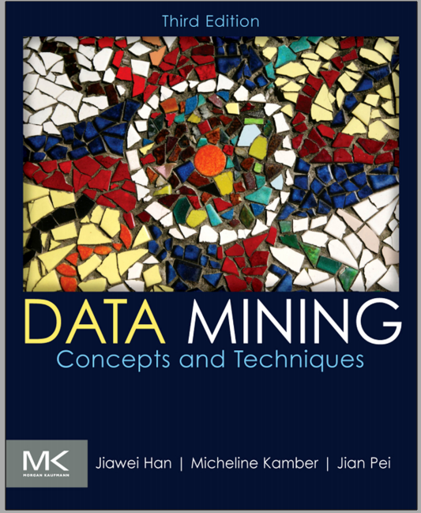
Main reference

Slide 49
Thank You !
Click to edit company slogan .

